Slide 1


Meeting Room Pro
Website: https://navsingh.org.uk/mrpro
Navjot Singh Virk
24/August/2017
Available On:
Github/Virksaabnavjot/MRPRO

Slide 2
Introduction
MeetingRoom Pro (Find, Review, Book)
Project Context
A room assistant application that allows the user to book rooms, navigate, see the building and the meeting room on the map, look at room gallery and upload images and review rooms .
Customers
The project has high potential and big corporate companies and educational Institutions are its primary customers
Which problem did you approach?
Finding the meeting room within buildings is hard and the app gives the functionality to find and book rooms on the same time in the same application and also have other features alongside.

Slide 3
Project Goals
How will you solve the problem and What are you trying to achieve?
Finding meeting rooms is a tough in huge buildings.
Solution:
By developing an easy to use iOS application. Which will allow its users to find, book, review rooms along with much more additional functionality to enhance the experience.

Slide 4


App Features Summary
FEATURE 1:
FEATURE 2:
Search Buildings
And
Meeting Rooms
View List of Available Buildings
And rooms available in them
with relevant hints and information

Slide 5




App Features Summary

Slide 6


List of Features
ROOM
DETAILS
SEARCH
LIST AND FIND
MAP
REVIEWS
GALLERY
PHOTO UPLOAD
BOOK ROOM
MY MEETINGS

Slide 7






System
Description
Client – iOS Application built with Swift 3 using Xcode IDE.
XCODE
SWIFT 3
JSON
MAPKIT
COCOAPODS
CORE LOCATION

Slide 8
Discussions
Advantages, Disadvantages?
Opportunities and Limits?
Future Perspectives?

Slide 9
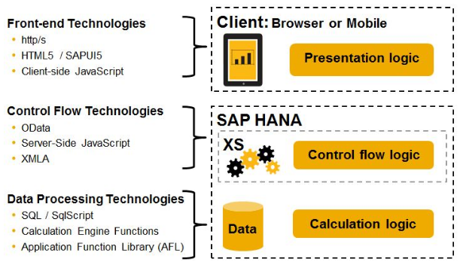
System
Architecture (SAP XS Engine)

Slide 10
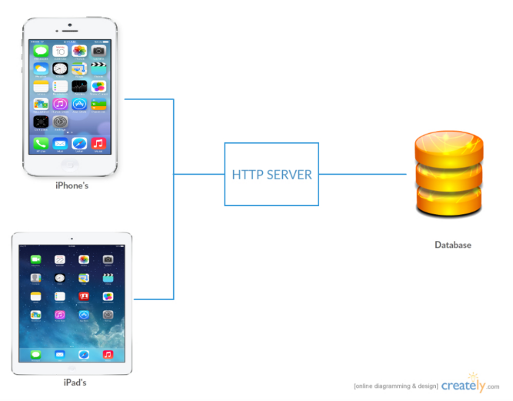
System
Architecture

Slide 11
System
Main algorithms
Room Booking
Maze Algorithm
Parsing JSON
Gallery Image Upload
Navigation
Geo-Location Notifications

Slide 12
Design
Overview of the main requirements
Functional
Easy to Use GUI
List and Find (Search)
Map / Navigation
Geo Location Notification
Booking System
Review

Slide 13
Main Requirements
System
Client – iOS 9+ iOS Devices
Internet Connection, GPS
Backend – SAP HANA with Geo Spatial Data Support

Slide 14
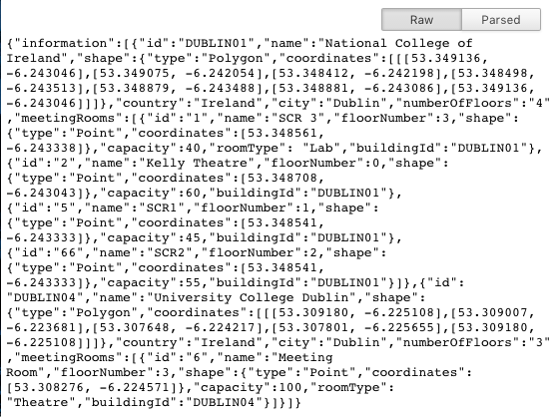
Main Requirements
Data
Building and Room information including co-ordinates (Geo Spatial Data – Polygons & Points)

Slide 15
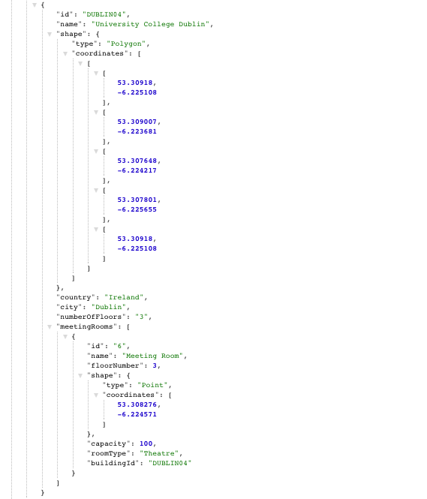
Parsed JSON Data Sample
returned by the Web Service
through http request that will
be consumed by the client
Application.

Slide 16
Evaluation
How will you evaluate the system?
The system will go through –
Subjective Evaluation
Unit Testing
System Testing

Slide 17
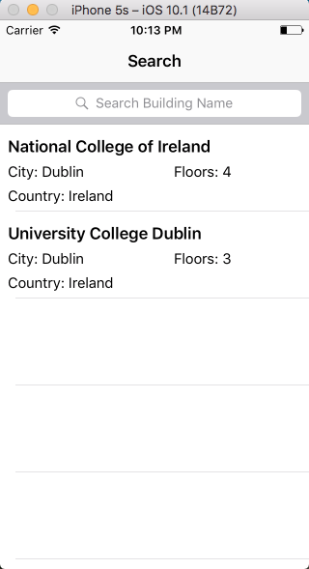
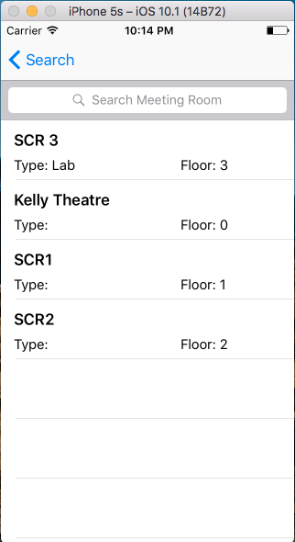
Demonstration
GUI (Screen Shots)
List of
Buildings
List of
Meeting
Rooms

Slide 18
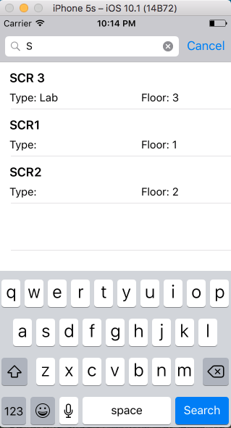
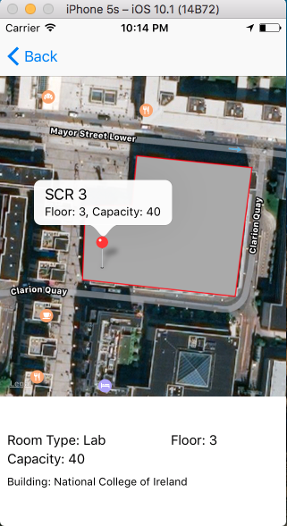
Demonstration (GUI)
Building drawn
on the map
&
With Selected
meeting
room
Search

Slide 19
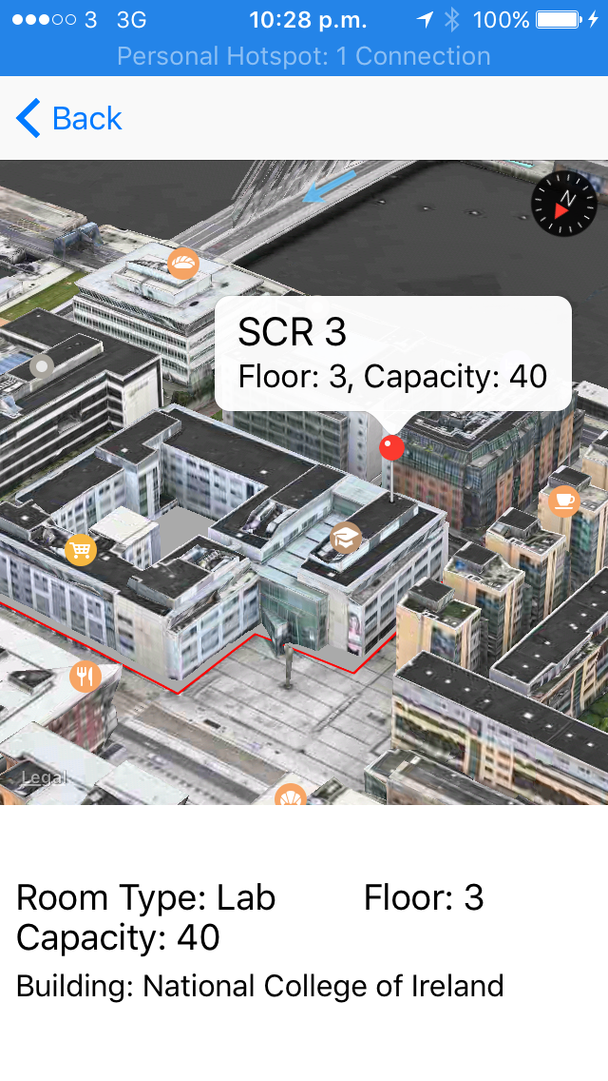
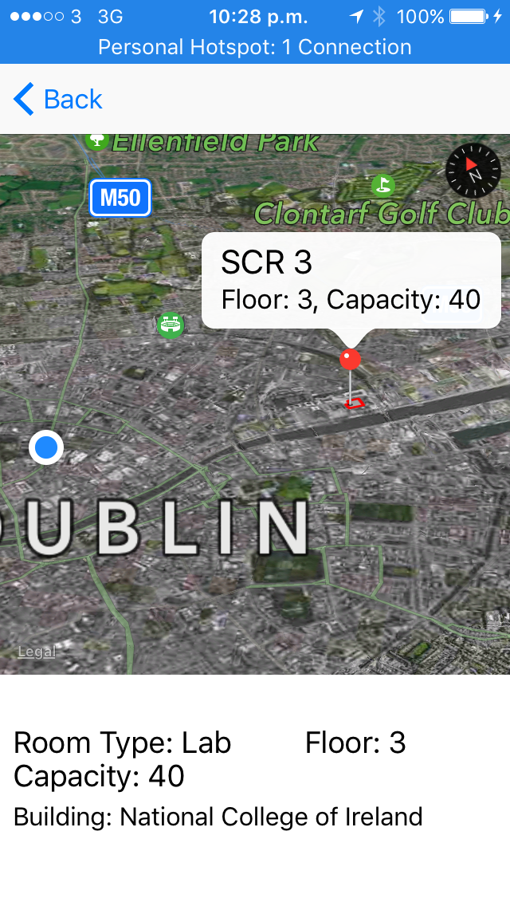
3D View Available through Apple Maps and Shows Current Location

Slide 20
Going Forward
Project Plan
Next Step after exams is to implement Room booking and Navigation features and then the rest of the features.

Slide 21
Discussion
General Discussion
Feedback

